Slide 1
Movie Dubbing Studio Manager
Course Project for AST lecture

Slide 2
Presentation Topics
Project description
First look to User Interface
Short demonstration of the application
Project architecture
Code review

Slide 3
Project Description
Notes:
The application helps to store data about ongoing dubbing projects to manage them. The application can store data about movies, persons, tags, publishers, users, genres.
C#, this programming language mainly supporting for WPF.
.Net Framework, its stores useful class collection and the important part is the WPF app needs to .Net to work and build the project.
EntityFramework, I used that as ORM framework. Basically, An Entity Framework does; managing Database via your table definitions and generates T-SQL queries via.
NInject, the library for Dependency Injection.

Slide 4
Application Screens
Notes:
Some screens are designed to operate CRUD operation for simple tables, that’s are named as Support Screens.
The other screen category is Master Screens, these screens using for CRUD operations like Support Screens.
But the differences are; table of the master screen is have one or more than one relation with other tables and that makes master screens to more complex.
Also, I didn’t use multiple window to be honest. The application have only one window. This window is hosting the user-controls, that’s means each screen actually an user-control.

Slide 5
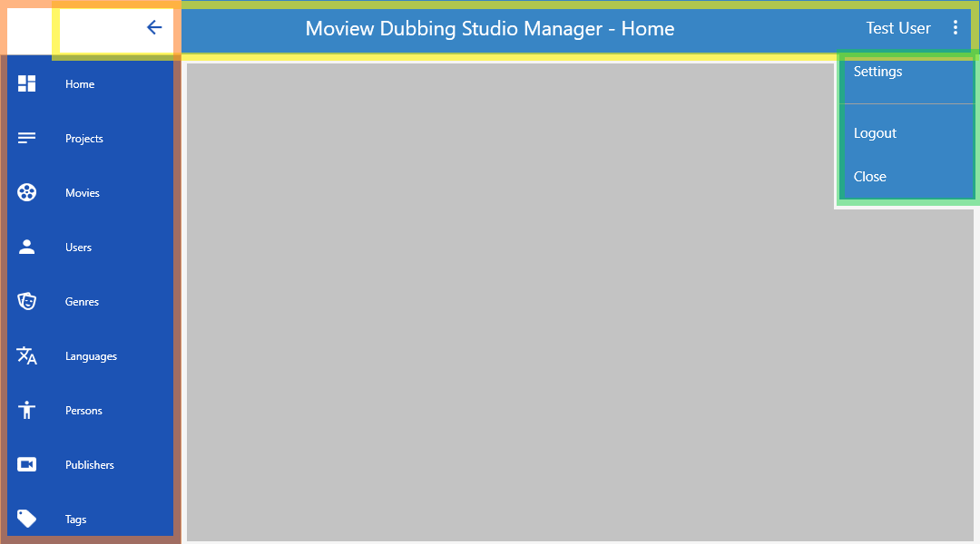
Main Window Layout

Slide 6
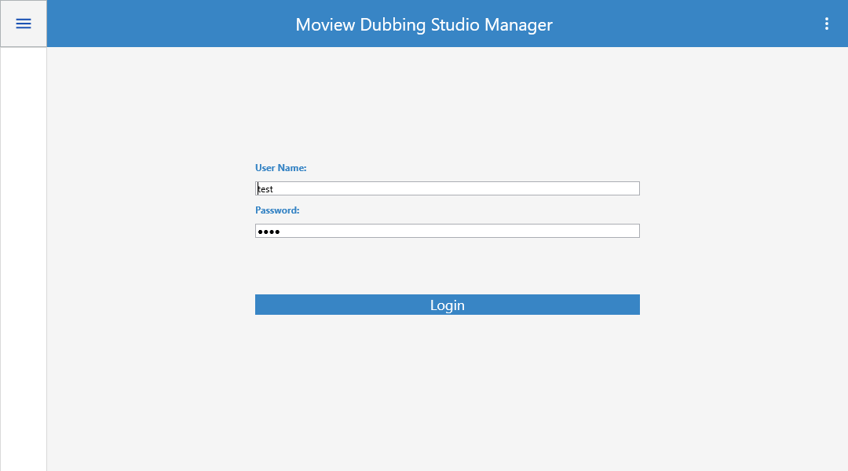
Login Screen

Slide 7
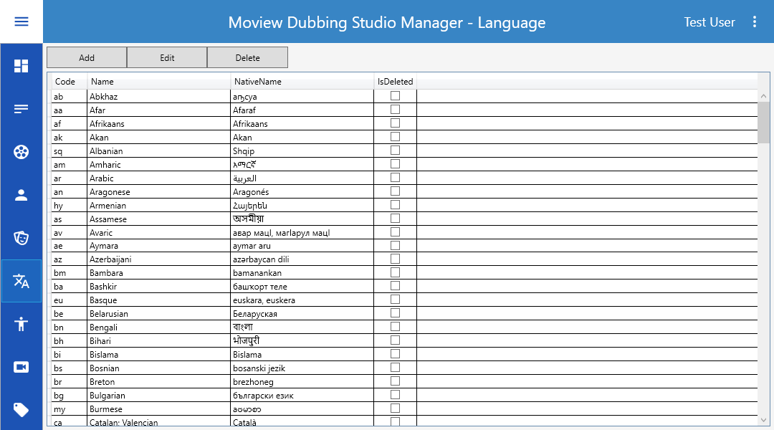
List Screen

Slide 8
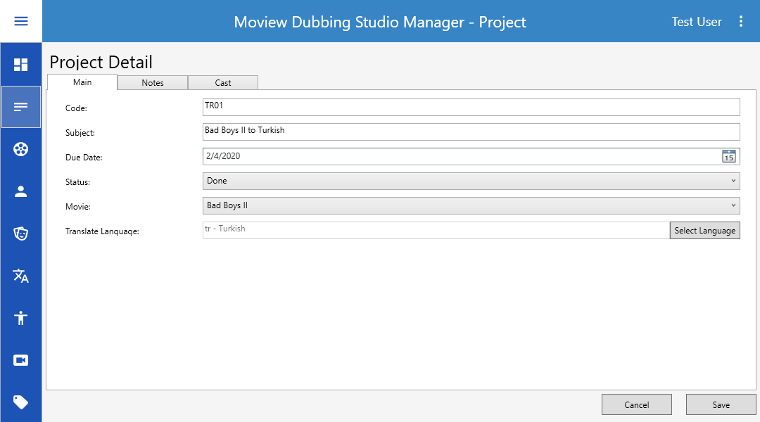
Detail Screen

Slide 9
Demo

Slide 10

Project Architecture

Slide 11

Code Review

Slide 12

Questions

Slide 13

About me
Sevcan Alkan
Software Engineer 1
E-Mail sevdzhan.alkan@scalefocus.com
Github https://github.com/SevcanAlkan
Pluralsight https://app.pluralsight.com/profile/sevcan-alkan

